Slide 1
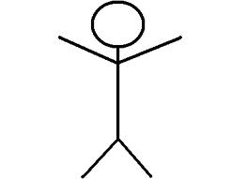
Write your target:
Great work. You can move on the ratio of volumes. Have a go at extension Question 1c Page 132.
Volume of Cuboid = L x W x H
Well done. Work out the simplest ratio of the area of these two triangles.
5cm
10cm
3cm
6cm
You need to practise simplifying ratios.
Simplify: a) 16 : 48 b) 5 : 15 : 30
Find a number that goes into all of them.
Simplify the ratios of these measurements. Remember to convert them both to the same unit. 10mm = 1cm
14cm : 280mm

