Slide 1
Year 12
Christmas C1 Quiz

Slide 2


Slide 3
Question 1.
What is the gradient of the graph with the equation 2y – 7x – 1 = 0?

Slide 4
Question 2.
What is the gradient of the line from the points (-4, -2) to (-1, -5)?

Slide 5
Question 3.
What is the equation of the line passing through (-2, 5) and (4, -1)?

Slide 6
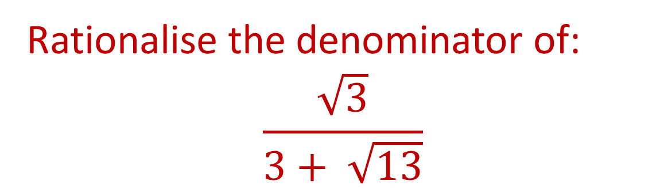
Question 4.
Rationalise the denominator of:
$$\frac{\sqrt{3}}{3+ \sqrt{13}}$$

Slide 7

Question 5.
Write as simply as possible:
$$3\sqrt{200}$$

Slide 8
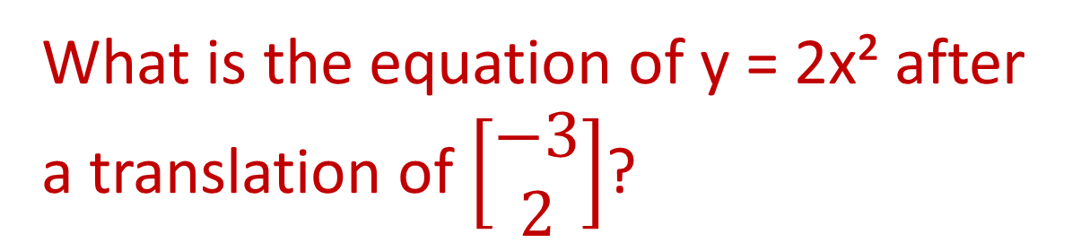
Question 6.
What is the equation of y = 2x² after a translation of $\left[\begin{matrix}−3 \\ 2\end{matrix}\right]$?

Slide 9
Question 7.
Write 3x² - 12x + 13 in the form a(x+b)² + c

Slide 10
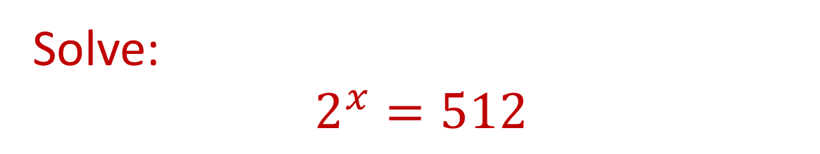
Question 8.
Solve:
$$2^{x}=512$$

Slide 11
Question 9.
Solve the inequality 14 - x² < 5x

Slide 12
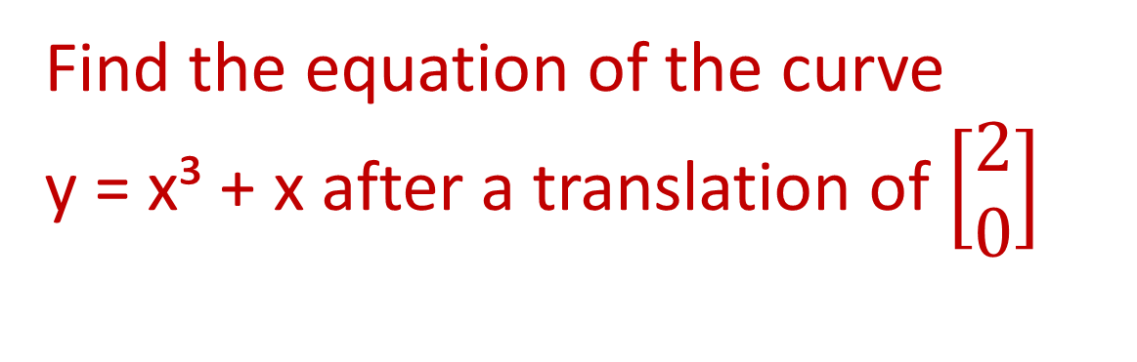
Question 10.
Find the equation of the curve
y = x³ + x after a translation of $\left[\begin{matrix}2 \\ 0\end{matrix}\right]$

Slide 13
Answers to Round One

Slide 14
Question 1.
What is the gradient of the graph with the equation 2y – 7x – 1 = 0?
Gradient is 3.5

Slide 15
Question 2.
What is the gradient of the line from the points (-4, -2) to (-1, -5)?
Gradient is -1

Slide 16
Question 3.
What is the equation of the line passing through (-2, 5) and (4, -1)?
y = -x + 3

Slide 17
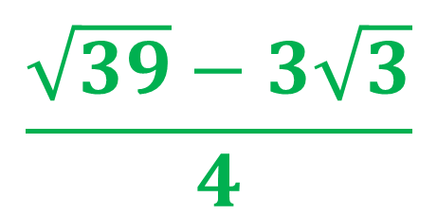
Question 4.
Rationalise the denominator of:
$$\frac{\sqrt{3}}{3+ \sqrt{13}}$$
$$\frac{\sqrt{39}−3\sqrt{3}}{4}$$

Slide 18
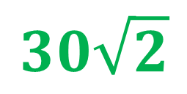
Question 5.
Write as simply as possible:
$$3\sqrt{200}$$
$$30\sqrt{2}$$

Slide 19
Question 6.
What is the equation of y = 2x² after a translation of $\left[\begin{matrix}−3 \\ 2\end{matrix}\right]$?
y= 2(x+3)² + 2

Slide 20
Question 7.
Write 3x² - 12x + 13 in the form a(x+b)² + c
3(x – 2)² + 1

Slide 21
Question 8.
Solve:
$$2^{x}=512$$
x = 9

Slide 22
Question 9.
Solve the inequality 14 - x² < 5x
x > 2 and x < 7

Slide 23
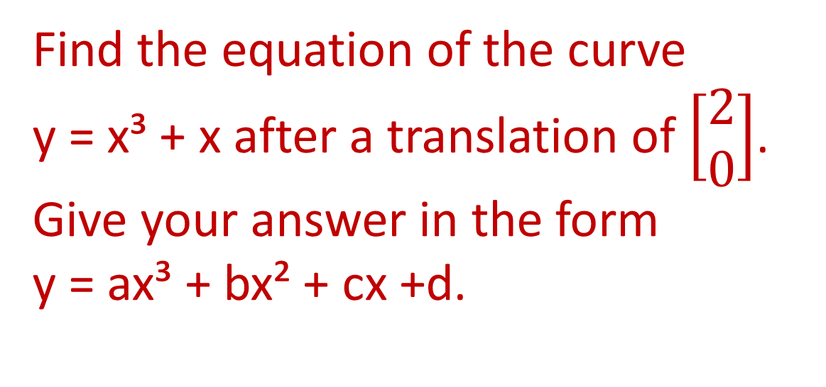
Question 10.
Find the equation of the curve
y = x³ + x after a translation of $\left[\begin{matrix}2 \\ 0\end{matrix}\right]$.
Give your answer in the form
y = ax³ + bx² + cx +d.
y = x³ - 6x² + 13x - 10

Slide 24


Slide 25
Question 1.

Slide 26
Question 2.

Slide 27
Question 3.

Slide 28
Question 4.

Slide 29
Question 5.

Slide 30
Answers to Round Two

Slide 31
Question 1.

Slide 32

Question 2.

Slide 33
Question 3.

Slide 34
Question 4.

Slide 35
Question 5.

Slide 36
Problem Round
5 points each

Slide 37

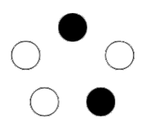
Problem 1.
Three white candles and two black candles can be arranged in a number of ways in a pentagon shaped candelabra.
If the candles are placed at random, find the probability that the three white candles will be adjacent.

Slide 38
Problem 2.
Snow White gave each of the elves a new scarf for Christmas. Grumpy, Sneezy and Doc were not happy with the colours and decided to exchange. Grumpy gave his red one to Sneezy in exchange for his yellow scarf. Grumpy then changed with Doc for the green one. Then Sneezy and Doc swapped scarves. Who has which scarf?

Slide 39
Problem 3.
At a family Christmas party, it was possible to count everyone there using the following descriptions:
1 grandmother | 1 brother
1 grandfather | 2 sisters
2 fathers | 2 sons
2 mothers | 2 daughters
4 children | 1 father-in-law
3 grandchildren | 1 mother-in-law
 | 1 daughter-in-law
This gives a total of 23 people.
But there were a lot less than that.
What is the LEAST number of people that could have been present in the room?

Slide 40
Answers to Problem Round

Slide 41
Problem 1.
Three white candles and two black candles can be arranged in a number of ways in a pentagon shaped candelabra.
If the candles are placed at random, find the probability that the three white candles will be adjacent.
Answer: As there are ten possible ways of filling the five candle holders, the probability of three whites being adjacent is 5/10 = 1/2.

Slide 42
Problem 2.
Snow White gave each of the elves a new scarf for Christmas. Grumpy, Sneezy and Doc were not happy with the colours and decided to exchange. Grumpy gave his red one to Sneezy in exchange for his yellow scarf. Grumpy then changed with Doc for the green one. Then Sneezy and Doc swapped scarves. Who has which scarf?
Answer:
Grumpy has the green one, Doc the red and Sneezy the yellow.

Slide 43
Problem 3.
At a family Christmas party, it was possible to count everyone there using the following descriptions:
1 grandmother | 1 brother
1 grandfather | 2 sisters
2 fathers | 2 sons
2 mothers | 2 daughters
4 children | 1 father-in-law
3 grandchildren | 1 mother-in-law
 | 1 daughter-in-law
This gives a total of 23 people.
But there were a lot less than that.
What is the LEAST number of people that could have been present in the room?
Answers:
7 people.

Slide 44
Have a very merry Christmas

