Slide 1
Christmas Quiz

Slide 2
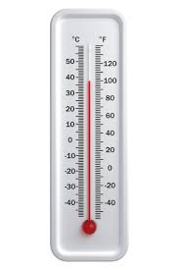
Question 1
At 6pm on Christmas Eve, the temperature is 3°C. By midnight, it has fallen by 9°C.
What is the temperature at midnight?

Slide 3
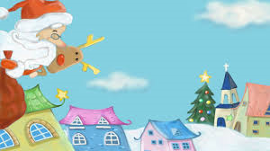
Question 2
Whilst delivering presents to houses on Pine Grove, Santa decides he will deliver to all the houses that are factors of 24 first.
Which houses does he deliver presents to first?

Slide 4
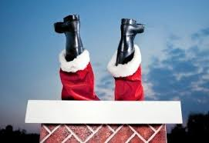
Question 3
In 1 minute, Santa can deliver presents to 5³ houses.
How many houses is this?

Slide 5
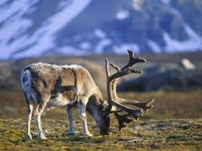
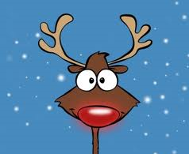
Question 4
Rudolf’s field has one pair of Parallel sides.
What is the shape of Rudolf’s field?

Slide 6
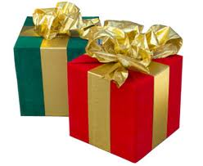
Question 5
Santa has wrapped all his presents in blue, red or green wrapping paper. He has 11 blue presents, 7 red and 3 green. He picks a present out at random.
What is the probability that the present is red? Give your answer in it’s simplest form.

Slide 7
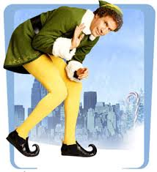
Question 6
Jimmy the elf spends 0.45 of his Christmas bonus on chocolate.
What is 0.45 as a fraction in it’s simplest form?

Slide 8
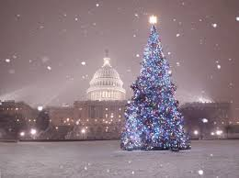
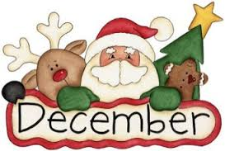
Question 7
There are 31 days in December.
How many hours is this?

Slide 9
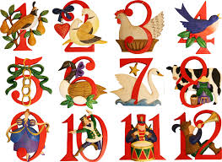
Question 8
On the 12th day of Christmas, how many gifts did my true love send to me?

Slide 10
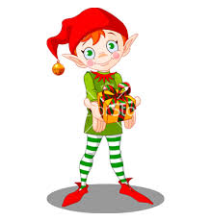
Question 9
An elf earns £750 over the Christmas period. He must pay 20% in taxes.
How much does he have left?

Slide 11
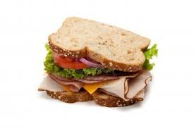

Question 10
Mrs Clause make Santa 42 turkey sandwiches for his Christmas Eve trip.
Santa only eats $\frac{3}{7}$ of them.
How many does he eat?

Slide 12
Answers

Slide 13
Question 1
At 6pm on Christmas Eve, the temperature is 3°C. By midnight, it has fallen by 9°C.
What is the temperature at midnight?
It has fallen to -6°C.

Slide 14
Question 2
Whilst delivering presents to houses on Pine Grove, Santa decides he will deliver to all the houses that are factors of 24 first.
Which houses does he deliver presents to first?
1, 2, 3, 4, 6, 8, 12, 24

Slide 15
Question 3
In 1 minute, Santa can deliver presents to 5³ houses.
How many houses is this?
125 houses

Slide 16
Question 4
Rudolf’s field has four sides. It has one pair of Parallel sides.
What is the shape of Rudolf’s field?
Trapezium

Slide 17

Question 5
Santa has wrapped all his presents in blue, red or green wrapping paper. He has 11 blue presents, 7 red and 3 green. He picks a present out at random.
What is the probability that the present is red? Give your answer in it’s simplest form.
$$\frac{1}{3}$$

Slide 18

Question 6
Jimmy the elf spends 0.45 of his Christmas bonus on chocolate.
What is 0.45 as a fraction in it’s simplest form?
$$\frac{9}{20}$$

Slide 19
Question 7
There are 31 days in December.
How many hours is this?
744 hours

Slide 20
Question 8
On the 12th day of Christmas, how many gifts did my true love send to me?
78

Slide 21
Question 9
An elf earns £750 over the Christmas period. He must pay 20% in taxes.
How much does he have left?
£600

Slide 22

Question 10
Mrs Clause make Santa 42 turkey sandwiches for his Christmas Eve trip
Santa only eats $\frac{3}{7}$ of them.
How many does he eat?
18

