Slide 1
Year 9
Christmas Quiz

Slide 2
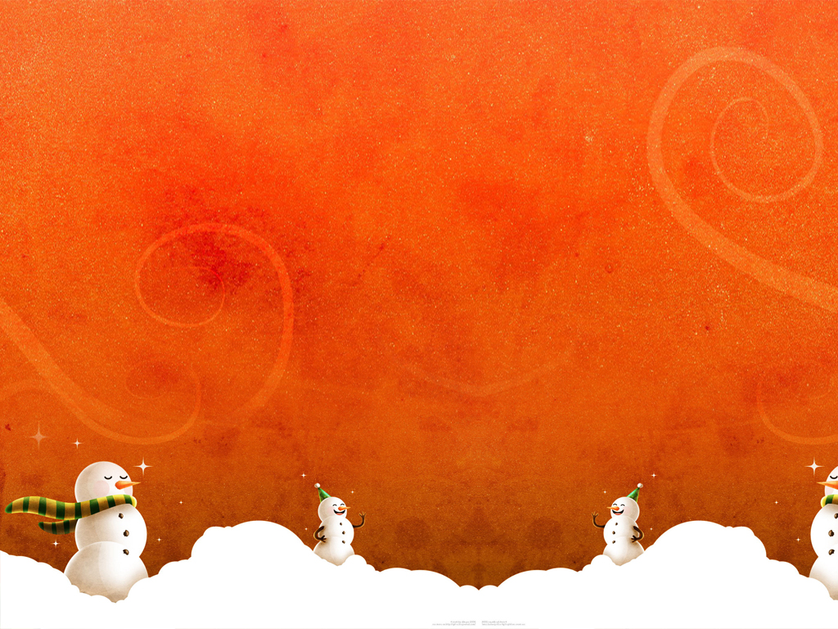
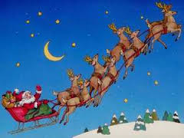
Question 1
Father Christmas wants to deliver presents on a long street in a special order using the nth term: 4n – 3
Which number house does he deliver 7th?

Slide 3
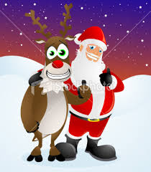
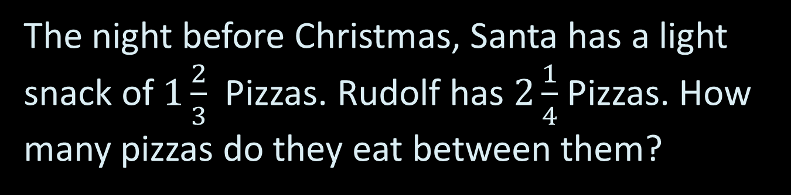
Question 2
The night before Christmas, Santa has a light snack of $1\frac{2}{3}$ Pizzas. Rudolf has $2\frac{1}{4}$Pizzas. How many pizzas do they eat between them?

Slide 4
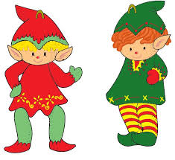
Question 3
Santa shares a Christmas bonus of £320 in the ratio 3 : 5 between two elves, Harry and Zain, respectively. How much of the bonus does Zain receive?

Slide 5
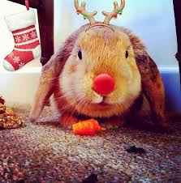
Question 4
During Christmas eve, Rudolf the Rednosed Reindeer eats 92, 685 carrots. What is this number rounded to 2 significant figures?

Slide 6
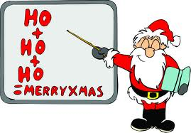
Question 5
Father Christmas is thinking of a number.
He adds 4.
Divides by 3.
Then multiplies by 5.
His answer is 25. What was the number he was thinking of?

Slide 7
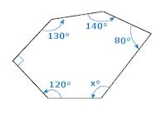
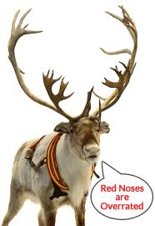
Question 6
Vixen has a hexagonal shaped field. This is a plan of his field:
What is the angle of the corner labelled x?

Slide 8
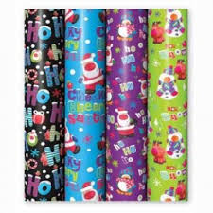
Question 7
Mrs Claus buys some rolls of wrapping paper, because her have all been used up!
The radius of her roll of paper is 11.3cm.
What is the diameter of her roll of wrapping paper?

Slide 9
Question 8
Over the years, Father Christmas has collected data on how long his deliveries take. He plots the number of houses that leave him some sherry and the hours the deliveries take him on a scatter graph:
What type of correlation does this scatter graph show?

Slide 10
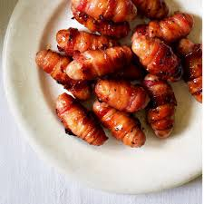
Question 9
Miss Wilson makes 84 pigs in blankets on Christmas day. She eats 70 of them.
What fractions does she eat? (In it’s simplest form)

Slide 11
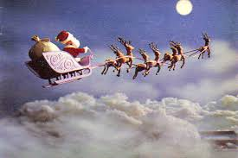
Question 10
Santa’s sleigh flies 800km before one of it’s sleighbells fall off. What is this in miles?

Slide 12
Bonus Question
How many VOWELS are there in the chorus of the song “Jingle Bells”?

Slide 13
ANSWERS

Slide 14
Question 1
Father Christmas wants to deliver presents on a long street in a special order using the nth term: 4n – 3
Which number house does he deliver 7th?
House number 25

Slide 15
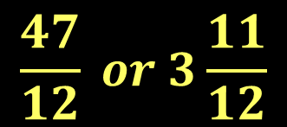
Question 2
The night before Christmas, Santa has a light snack of $1\frac{2}{3}$ Pizzas. Rudolf has $2\frac{1}{4}$Pizzas. How many pizzas do they eat between them?
$$\frac{47}{12} or 3\frac{11}{12}$$

Slide 16
Question 3
Santa shares a Christmas bonus of £320 in the ratio 3 : 5 between two elves, Harry and Zain, respectively. How much of the bonus does Zain receive?
£200

Slide 17
Question 4
During Christmas eve, Rudolf the Rednosed Reindeer eats 92, 685 carrots. What is this number rounded to 2 significant figures?
93,000 carrots

Slide 18
Question 5
Father Christmas is thinking of a number.
He adds 4.
Divides by 3.
Then multiplies by 5.
His answer is 25. What was the number he was thinking of?
11

Slide 19
Question 6
Vixen has a hexagonal shaped field. This is a plan of his field:
What is the angle of the corner labelled x?
160°

Slide 20
Question 7
Mrs Claus buys some rolls of wrapping paper, because her have all been used up!
The radius of her roll of paper is 11.3cm.
What is the diameter of her roll of wrapping paper?
22.6cm

Slide 21
Question 8
Over the years, Father Christmas has collected data on how long his deliveries take. He plots the number of houses that leave him some sherry and the hours the deliveries take him on a scatter graph:
What type of correlation does this scatter graph show?
Positive correlation

Slide 22

Question 9
Miss Wilson makes 84 pigs in blankets on Christmas day. She eats 70 of them.
What fractions does she eat? (In it’s simplest form)
$$\frac{5}{6}$$

Slide 23
Question 10
Santa’s sleigh flies 800km before one of it’s sleighbells fall off. What is this in miles?
500 miles

Slide 24
Bonus Question
How many VOWELS are there in the chorus of the song “Jingle Bells”?
58 – 5 points
57 or 59 – 4 points
56 or 60 – 3 points
55 or 61 – 2 points
54 or 62 – 1 point
58 vowels

Slide 25
Merry Christmas

